Slide 1
FIT1045 Introduction to Algorithms and Programming Lecture 13 Divide and Conquer
COMMONWEALTH OF AUSTRALIA
Copyright Regulations 1969
WARNING
This material has been reproduced and communicated to you by or on behalf of Monash University pursuant to Part VB of the Copyright Act 1968 (the Act).The material in this communication may be subject to copyright under the Act.Any further reproduction or communication of this material by you may be the subject of copyright protection under the Act.
Do not remove this notice.

Slide 2
Divide and Conquer
Divide instances of problem into 2 or more smaller instances
Solve smaller instances (recursively)
Combine solutions to obtain solution to bigger instances

Slide 3
Overview
Power
Binary Search
Finding roots
Triominoes

Slide 4
Iterative Approach
Algorithm Power(x, N)
// Computes the x to the power of N
// Input: A real number x and a positive integer N
// Output: returns x^{N}
value ⟵ 1
for k ⟵ 1 to N
value ⟵ value * x
return value

Slide 5
Iterative Approach
def power(x, n):
’computes x to the power of n’
value = 1
for k in range(n):
value *= x
return value

Slide 6
Using the iterative algorithm below, how many * and = operations are performed?
value = 1
k = 0
while k < 100:
value = value * 2
k = k+ 1
print(value)
102
202
302
None of the above

Slide 7
Divide and Conquer Approach
If N is even, then
So when N is even to compute x^{N} we first compute x^{N//2}
If N is odd, then
So when N is odd to compute x^{N} we first compute x^{N//2}

Slide 8
For example:
3**10 = 3**5 * 3**5
= 243 * 243 =59409
3**5 = 3**2 * 3**2 * 3
= 9 * 9 * 3 = 243
3**2 = 3 * 3 = 9

Slide 9
If you use this divide and conquer approach to compute 2**100, how many * and = operations are performed?
10
14
20
None of the above

Slide 10
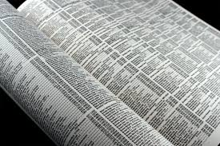
Finding a phone number
Consider the problem of trying to find a telephone number in a phone book
given a name
Gertrudis Atkinson 0463935372
Kiley Basinger 0411484152
Romana Brose 0418721183
Shayne Brotherton 0436242684
Calandra Clifton 0479753034
Roy Dupuis 0445778949
Leticia Fukushima 0436756947
Cherlyn Gayles 0483503919
…

Slide 11
Approach
// Input: A name
// Output: The phone number corresponding to the name
Look at the first record
Does the record have the name?
Print phone number in record
YES
NO
Is there another record?
Look at next record
YES
NO
Stop

Slide 12
Finding Phone Number
"Search Phone Book for number"
infile = open("phoneBook.txt")
name = input("Enter name: ”)
for line in infile:
if name in line:
parts = line.split()
print(parts[2])

Slide 13
How many phone numbers for a given name will be found by this Python code?
"Search Phone Book for number"
infile = open("phoneBook.txt")
name = input("Enter name: ”)
for line in infile:
if name in line:
parts = line.split()
print(parts[2])
None
Exactly one
More than one
All of the above

Slide 14
Binary Search
If ( target == middle item )
target is found
else if ( target < middle item )
search left-half of list with the same method
else
search right-half of list with the same method

Slide 15
Binary Search Case 1:
target = 10 (middle item)
a:
1
5
7
9
10
10
13
17
19
27
0
1
2
3
4
5
6
7
8
mid
Return True

Slide 16
Binary Search Case 2:
target = 19
a:
1
5
7
9
10
13
13
17
17
19
19
27
27
0
1
2
3
4
5
6
7
8
mid
Search right-half of list using the same algorithm

Slide 17
Binary Search Case 3:
target = 7
a:
1
1
5
5
7
7
9
9
10
13
17
19
27
0
1
2
3
4
5
6
7
8
mid
Search left-half of the list using the same algorithm

Slide 18
Binary Search
def binarySearch(aList, target):
’returns true if target is in aList’
‘Assumes that aList is sorted in ascending order’
low = 0
high = len(aList)-1
while low <= high:
mid = (low + high) // 2
if aList[mid] == target:
return True
elif aList[mid] > item:
high = mid-1
else:
low = mid+1
return False

Slide 19
Binary Search Assumptions
The list is sorted
Assume in ascending order
That we can randomly access the list.

Slide 20
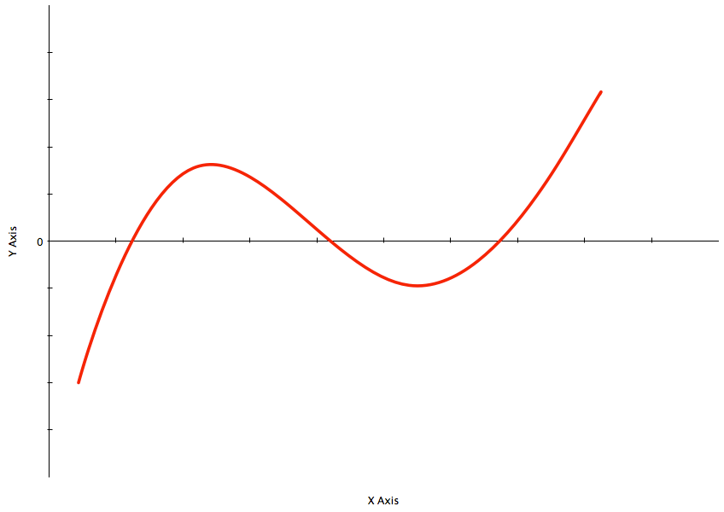
Find a root

Slide 22
a
b
>0
<0
Assume that the function is continuous

Slide 23
a
mid
b
>0
<0

Slide 24
a
b
mid= (a+b)/2
>0
<0
<0

Slide 25
a
mid= (a+b)/2
b
>0
<0
<0
<0

Slide 26
a
b
>0
<0
<0

Slide 27
a
b
>0
>0
<0
<0
mid= (a+b)/2

Slide 28
a
b
>0
<0

Slide 29
a
b
>0
<0
mid= (a+b)/2

Slide 30
Triominoes
Triominoe
Can you cover the blank squares of the above grid with non-overlapping triominoes that do not go outside the grid?
Notes:
30

Slide 31
Can you cover the blank squares of this grid with non-overlapping triominoes that do not go outside the grid?
Yes
No

Slide 32
Divide

Slide 33
Reduce to Similar Problem

Slide 34
Divide Again

Slide 35
Reduce Again

Slide 36
Divide and Conquer
In divide and conquer, we break large instances into …
1 or more smaller instances
2 or more instances
And combine solutions to the smaller instances to find …
A solution to the original problem
A solution to a different problem

Slide 37
Before Next Lecture
Log onto the FIT1045 Moodle site:
Watch the following videos:
Recursion I – What is Recursion?
The Towers of Hanoi
Attempt the following problem …

Slide 38
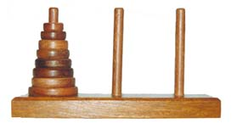
Tower of Hanoi
In the great temple at Benares beneath the dome which marks the centre of the world, rests a brass plate in which are fixed three diamond needles, each a cubit high and as thick as the body of a bee. On one of these needles, at the creation, God placed sixty-four disks of pure gold, the largest disk resting on the brass plate and the others getting smaller and smaller up to the top one. This is the Tower of Brahma. Day and night unceasingly, the priest transfer the disks from one diamond needle to another according to the fixed and immutable laws of Brahma, which require that the priest on duty must not move more than one disk at a time and that he must place this disk on a needle so that there is no smaller disk below it. When all the sixty-four disks shall have been thus transferred from the needle on which at the creation God placed them to one of the other needles, tower, temple and Brahmins alike will crumble into dust, and with a thunderclap the world will vanish.
- Henri de Parville (La Nature)
Image at: mmvr41.blogspot.com/2005_01_01_archive.html
Notes:
38

